Slide 1

ASHRAE PROJECT COMMITTEE TRAINING DUPLICATION/
HARMONIZATION OF STANDARDS AND
GUIDELINES
Updated: June 2025

Slide 2
INTENDED AUDIENCE
The intended audience for this training presentation is members and potential members of ASHRAE Standard and Guideline Project Committees. It is not intended to go into detail on topics/tasks that are only of relevance to Project Committee chairs (such as creating online ballots, balancing committee membership, etc.). These topics are covered in depth in other training materials. Please refer to the ASHRAE PCs Toolkit for additional information.

Slide 3
PROCEDURAL REFERENCES
Procedures for ASHRAE Standards Actions (PASA)
PCs Guide to PASA
ANSI Essential Requirements
Refer to the PCs Toolkit webpage for the most current versions.

Slide 4
TERMS/ACRONYMS/DEFINITIONS
TERM | DEFINITION
conflict (between standards) | A situation where, viewed from the perspective of an implementer, the terms of one standard are inconsistent with the terms of another standard such that implementation of one standard necessarily would preclude proper implementation of the other standard in accordance with its terms.
Project Initiation Notification System (PINS) | A form used to request an announcement in ANSI Standards Action of a project initiation notification and is intended to complement other such announcements made by ANSI-Accredited Standards Developers (ASD) to advise the public and materially affected interests of standards development activity and the opportunity for participation.
purpose (standard or guideline) | A statement which describes in general terms what the standard or guideline accomplishes.
scope (standard or guideline) | A statement which describes what is included in or covered by the standard or guideline.
TPS | Title, Purpose, and Scope

Slide 5
COORDINATION AND HARMONIZATION (OF STANDARDS)
ANSI and ASHRAE procedures require that “good faith efforts” be made to resolve potential conflicts and to coordinate standards activities between and among existing and proposed American National Standards (ANS).
ASHRAE Standards Committee will not approve a standard, guideline, or addendum for publication if the PASA requirements for “conflict” (Section 7.6.1d) and “duplication” (Section 7.6.1e) are not met.
PASA Section 7.6.1d: “Any identified conflict with another ASHRAE or American National Standard was addressed in accordance with the ANSI ER”
PASA Section 7.6.1e: “Other known national standards were examined with regard to harmonization and duplication of content, and if duplication exists, there is a compelling need for the standard”

Slide 6
COORDINATION AND HARMONIZATION (OF STANDARDS)
The ASHRAE website hosts a listing of the Title, Purpose, and Scope (TPS) for every published and proposed ASHRAE standard and guideline
ANSI maintains lists of approved and proposed American National Standards (ANSs), which can be downloaded from https://www.ansi.org/american-national-standards/info-for-standards-developers/ans-complete-lists.
Proposals for new ASHRAE and ANSI standards are announced in each organizations’ weekly newsletters.
  ASHRAE Standards Actions
  ANSI Standards Action

Slide 7
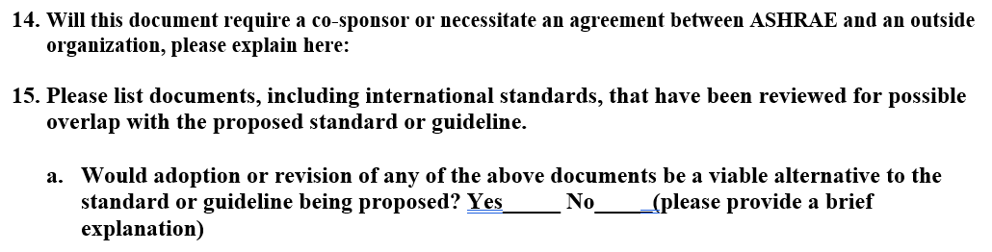
REVIEW FOR POSSIBLE SCOPE OVERLAP
When proposing a new ASHRAE standard and guideline, the proposer is asked for a list of documents which have been reviewed for possible overlap with the proposed standard or guideline. Proposers are also asked to confirm that adoption or revision of any cited documents might be a viable alternative to ASHRAE developing a new document.
If there is possible overlap with a standard from another developer, inviting them to co-sponsor the proposed document may assist in efforts to avoid or resolve potential conflicts.

Slide 8
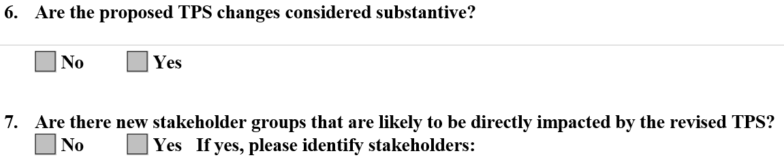
REVISION OF AN APPROVED TPS
If a PC determines that changes to an approved TPS are warranted, the proposed changes must be submitted to the ASHRAE Manager of Standards for approval prior to submission of a standard, guideline, or addendum for public review. Changes to an approved TPS require approval by SPLS and Standards Committee.
Notice of a revised TPS and a call for comments will be announced in ASHRAE Standards Actions. If new stakeholder groups are identified who may be affected by the standard or guideline, a call for members will also be announced.

Slide 9
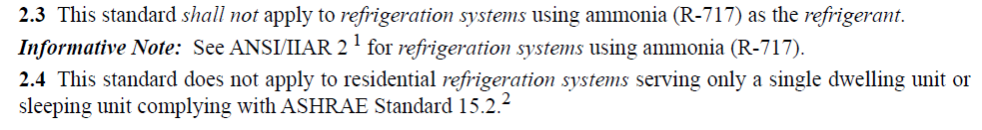
SCOPE COORDINATION
When approving a new or revised TPS for a standard or guideline, the Standards Committee may instruct that the proposer/project committee to revise their scope to clearly delineate that it does not overlap with the scope of another standard or guideline.
The below excerpt from the scope of ANSI/ASHRAE Standard 15-2024, Safety Standard for Refrigeration Systems, clearly and explicitly denotes certain systems and scenarios which fall within the scopes of other standards.
In this particular example, depending on the particular application, it is possible that the exact same model system could fall within the scope of either Standard 15 or Standard 15.2 (e.g., the same type of systems could be used for both apartments and lobbies in the same building).

Slide 10
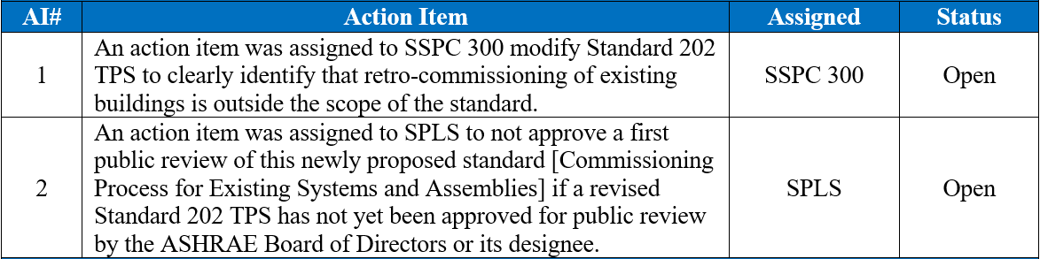
SCOPE COORDINATION (EXAMPLE)
Below is an example of Standards Committee assigning action items to a PC to revise the scope of an existing standard to ensure that there is clear delineation between the scope of the existing standard and a proposed new standard related to the same topic (i.e., commissioning).

Slide 11
RESPONDING TO ASSERTIONS OF CONFLICT/DUPLICATION
When development of a new standard is approved, a Project Initiation Notification System (PINS) form is submitted to ANSI, and the proposed project intent and scope is announced in the ANSI Standards Action newsletter. The TPS of the proposed standard is also typically posted for a 30-day public review in the ASHRAE online comment database.
If comments are received by ASHRAE within thirty days of the PINS announcement asserting that the proposed standard duplicates or conflicts with an existing published or proposed ANS, ANSI mandates a deliberation between ASHRAE and the commenter within 90 days. The purpose of the deliberation is to provide the relevant stakeholders with an opportunity to discuss whether there is a compelling need for the proposed standards project.

Slide 12
CONFLICT (BETWEEN STANDARDS)
Per PASA, a conflict (between standards) “refers to a situation where, viewed from the perspective of an implementer, the terms of one standard are inconsistent with the terms of another standard such that implementation of one standard necessarily would preclude proper implementation of the other standard in accordance with its terms.”
In practice, this means that compliance with the requirements of one standard will necessarily prohibit compliance with the requirements of another standard.
Note: It is permissible for one standard to set stricter requirements than a corresponding standard; this does NOT constitute a conflict per PASA.

Slide 13
EXAMPLE - SCENARIO 1: CONFLICT
Standard A | Standard B
5.4 Maximum Flow Rate The maximum flow rate for domestic hot water piping with a diameter of 2 inches shall not be greater than 50 GPM (gallons per minute). | 5.4 Minimum Flow Rate The minimum flow rate for domestic hot water piping with a diameter of 2 inches shall not be less than 100 GPM (gallons per minute).
As it is not possible to have a flow rate in the same pipe which is simultaneously less than 50 GPM and greater than 100 GPM, it is not possible to comply with the requirements of both standards at the same time. Therefore, these standard requirements ARE IN CONFLICT.

Slide 14
EXAMPLE - SCENARIO 2: NO CONFLICT
Standard A | Standard B
5.4 Minimum Flow Rate The minimum flow rate for domestic hot water piping with a diameter of 2 inches shall not be less than 50 GPM (gallons per minute). | 5.4 Minimum Flow Rate The minimum flow rate for domestic hot water piping with a diameter of 2 inches shall not be less than 100 GPM (gallons per minute).
In this example, one standard sets a higher minimum flow rate than the related standard; the requirements of both standards can be satisfied by using the higher of the two values for the minimum flow rate. While these two requirements are inconsistent between the two standards, it is possible to comply with both requirements simultaneously. Therefore, these standard requirements ARE NOT IN CONFLICT.

Slide 15
“GOOD FAITH” EFFORTS TO RESOLVE CONFLICTS
ANSI dictates that a “good faith” effort requires substantial, thorough, and comprehensive efforts to harmonize proposed and existing American National Standards.
The developer of a proposed standard shall retain evidence of such efforts in order to demonstrate compliance with this requirement.
ANSI and ASHRAE do not necessarily dictate that these efforts take any particular form and understand that not all efforts will be successful.
Whatever form efforts take (e.g., ad hoc groups, working groups, meetings with objectors or other standards developers), it is crucial that these efforts be documented in meeting minutes, emails, etc.
PCs may appoint liaisons to other committees (project committees, technical committees, etc.) who can report on developments of interest and can help initiate efforts to harmonize.

Slide 16



PC EXPECTIONS FOR DUPLICATION/HARMONIZATION
Examine other known standards for conflicts and keep records of these evaluations.
Pursue findings and/or allegations of duplication or lack of harmonization. Notify the PC’s SPLS liaison and ASHRAE staff liaison if allegations related to duplication and harmonization are made.
Exercise and document good faith efforts to resolve allegations and findings (e.g., ad hoc committees, working groups, meetings with objectors, etc.). Where duplication is deemed necessary, formally document the compelling need for the standard.

Slide 17
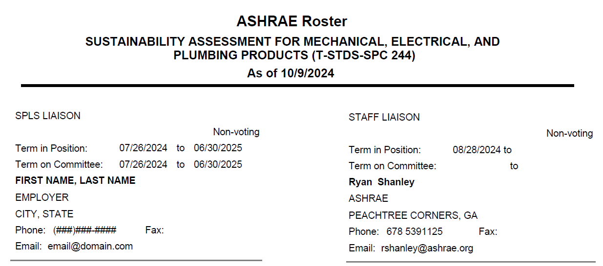
QUESTIONS/ASSISTANCE
Every ASHRAE project committee is assigned both an SPLS liaison and an ASHRAE staff liaison, either of whom is an invaluable resource for guiding/assisting the PC’s work.
The names of the committee’s assigned SPLS and staff liaisons can be found at the very end of the committee membership roster.

Slide 18
STANDARDS SECTION STAFF
Direct Phone Line: (678) 539-XXXX (Ext.)
Staff Member | Email Address | Ext.
Standards Committee, SPLS Ryan Shanley, Senior Manager of Standards | rshanley@ashrae.org | 1125
Procedures, PPIS, SRS, Appeals Tanisha Meyers-Lisle, Asst. Manager of Standards - Administration | tmlisle@ashrae.org | 1111
General Inquiries/Assistance Standards Section | standards.section@ashrae.org

